Slide 1
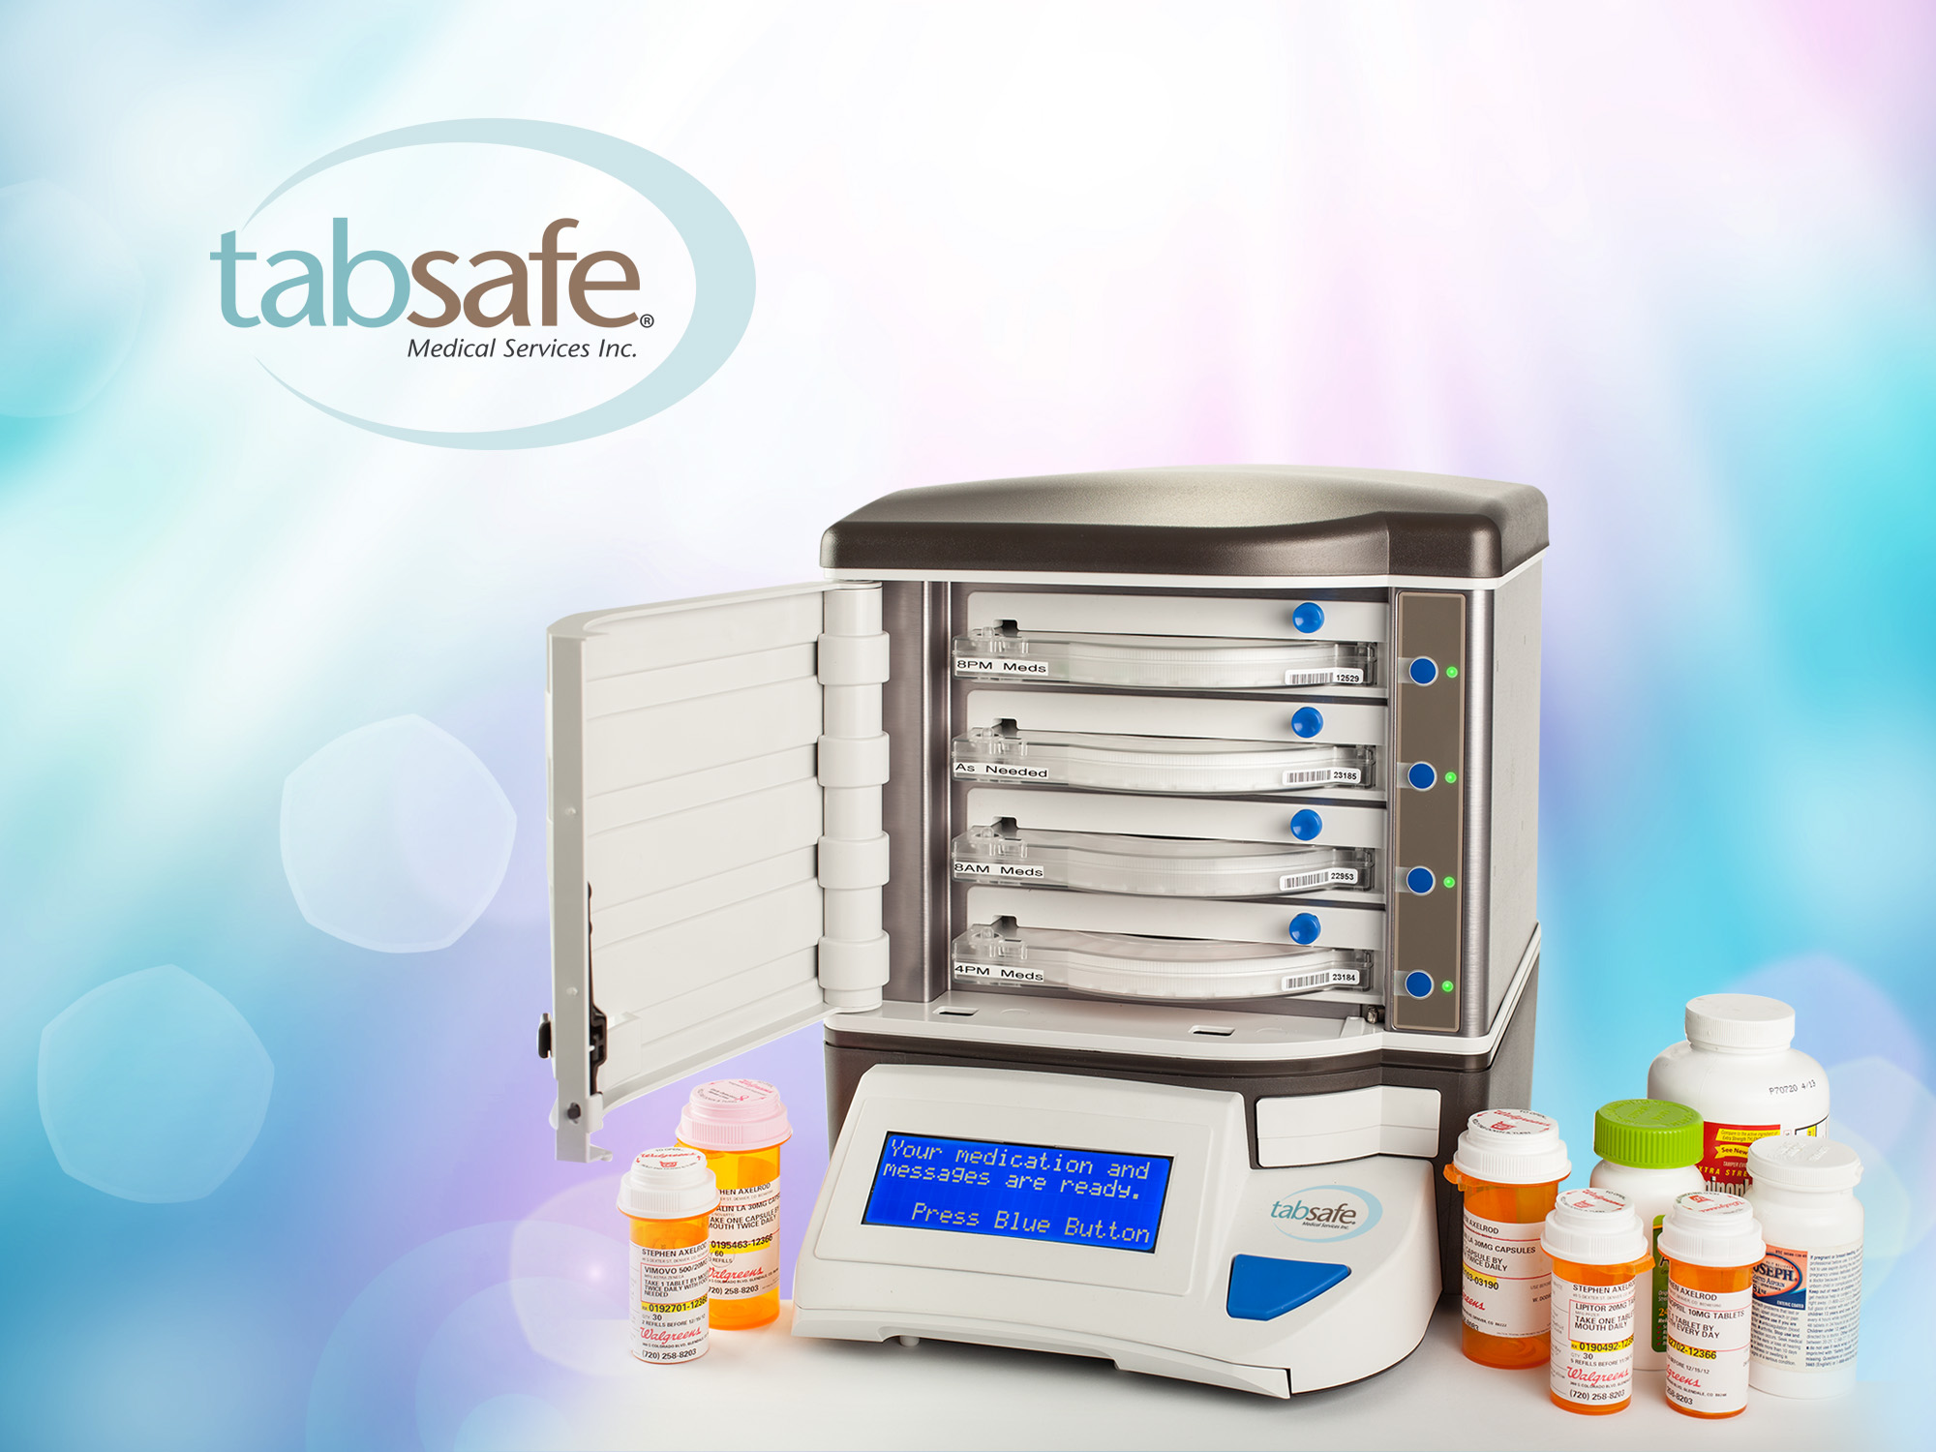
Healthcare Unbound
San Diego, CA
Medication Adherence Technologies
July 12, 2011
Stephen L. Axelrod, M.D.
www.tabsafe.com

Slide 2

The Growing Problem
  MEDICATION NONADHERENCE
  51% of all prescription medication in the U.S. is taken incorrectly causing:
    125,000 deaths per year
    1,000,000 hospitalizations
    Among the elderly, nonadherence accounts for 30-40% of all hospital admissions

Slide 3

Medication Nonadherence
RESULTS IN:
• 1/3 to 2/3 of all medication-related hospitalizations
• 23% of all nursing home admissions
• An estimated 188.3 MM medical visits wasted because patients do not follow advice received
• Unnecessary medication changes and unexplained treatment failures
•Increased use of expensive, specialized medical resources

Slide 4
How costly is it?
Estimated
direct costs
+
Indirect costs
annually¹
=
$177 Billion
1. National Council on Patient Information and Education. Enhancing Prescription Medication Adherence: A National Action Plan. August 2007.
Estimated
direct costs
+
Indirect costs
annually²
=
$290 Billion
2. CVS Caremark, Harvard University, and Brigham & Women’s Hospital. August 2010
Estimated
direct costs
+
Indirect costs
annually³
=
$258 Billion
3. Express Scripts, Reported in USA Today May 27, 2011
Notes:
4
Typical adherence rate for chronic medication treatment is 50%.¹
A 2008 literature review of 139 studies reporting medication compliance and persistence data reported only an average of 63% of patients continue to take their medications for a year. Also, the medication possession ratio, defined as the number of days on treatment divided by the number of days between prescription refill, was 72% (dyslipidemia, hypertension, and diabetes medications).²
The relationship between compliance and outcome was investigated in 41 of the 50 states reporting outcomes. In 30 states (73%), the effect of good compliance on outcome was positive. Only 8 studies (20%) found good compliance to have a neutral or implied neutral effect on outcomes.²
When conditions are treated sub optimally, complications can be more severe and the risk for hospitalization increases. The result is poor health outcomes and increased healthcare costs.
Estimated direct and indirect costs annually are $177 billion.³
References:
Sabaté E. Adherence to Long-term Therapies: Evidence for Action. Full Report. World Health Organization; 2003.
Cramer JA, Benedict A, Muszbek N, et al. The Significance of Compliance and Persistence in the Treatment of Diabetes, Hypertension and Dyslipidemia: a Review. Int J Clin Pract. 2008;62:76-87.
National Council on Patient Information and Education. Enhancing Prescription Medication Adherence: a National Action Plan. August 2007.

Slide 5
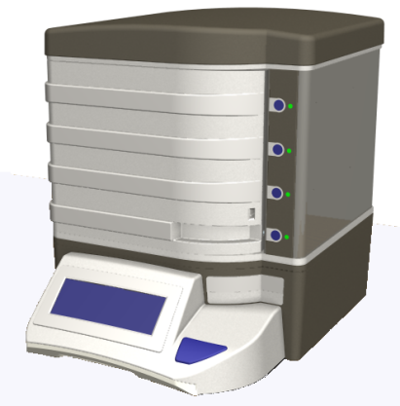
What is TabSafe?
  ─ Personal medication management system that securely stores medications to be dispensed on a specific time schedule
  Medications can be filled by pharmacies, by users, their family members, or home care companies
  Sends visual and auditory reminders for medication adherence with verification of completion
  3 follow-up calls to prevent nonadherence
  Reminders for activities of daily living and for medications not stored in TabSafe

Slide 6
TabSafe is Unique
  Manages “As Needed” meds and prevents over-usage
  Maintains each medication’s inventory, automatically alerts for reorder, digitally downloads each transaction for reports and analysis. When released, What med, quantity, Who released
  Web accessible reports allow for the management of medications from any web browser
  Allows for interactive medication dose changes or discontinuance when prescription changes
  Collects, records, and correlates vital sign and biometric data to medication adherence data

Slide 7
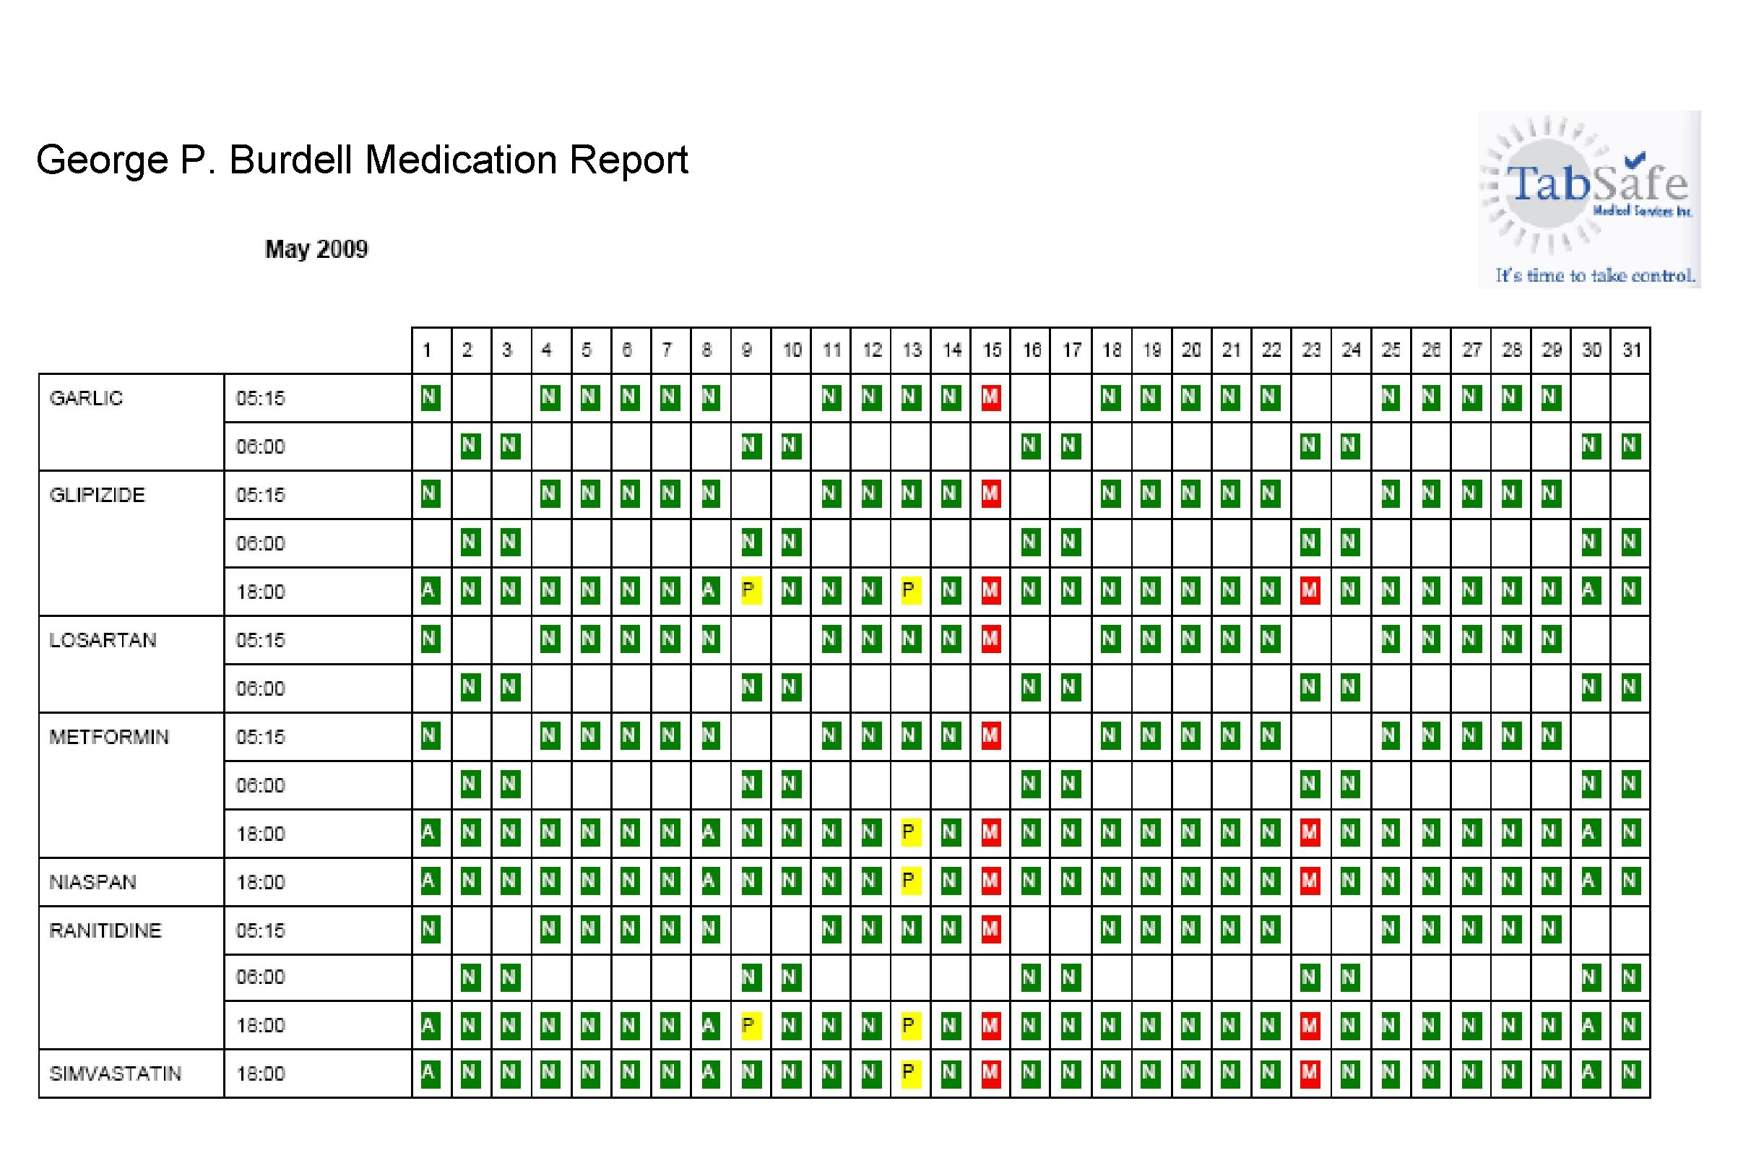
Web-Accessible Reports
Medication Report
Release Report
Inventory Report

Slide 8
Reducing Readmissions
Care Transitions Interventions (CTI©)
Medication adherence (25-30%)
Medication reconciliation (15%)
Access to hospital records
Physician appointment scheduled within 7 days of discharge
Patient emergency plan
Transition coaching
Notes:
8

Slide 9
Integrated Technologies
        “Developed more recently, integrated medication adherence technologies integrate pill dispenser and reminder systems with general health monitoring or health information storage.”
        Results: Improved mean medication adherence rates of over 92% compared to a 40% baseline medication adherence rate.
        Technologies for Optimizing Medication Use in Older Adults, Center for Technology and Aging, Sacramento, CA, October 2009.
      .

Slide 10
TabSafe Improves Adherence
 | Released | Taken | Missed | %Adherence
Assisted Living* | 4802 | 3414 | 1388 | 71.10%
AL with TabSafe | 312358 | 310286 | 2072 | 99.34%
Medication Errors (Missed Med Time) in Assisted Living
*Young H, Carley MM, AHCA/NCAL/MECF 58th Annual Convention and Exposition. White Paper: Medication Management in Assisted Living, October 7-10, 2007
 | Released | Taken | Missed | %Adherence
Independent |  |  |  | 40.00%
Indy with TabSafe | 159325 | 153730 | 5595 | 96.49%
Independently Living Individuals Using TabSafe vs. Nat’l Average
Actual YE 2011 Results across 5 Different Distributors

